Slide 1
P-427 REGRESSION - SOLAR PANEL
GROUP MEMBERS:
ANJANA SREERAJ
BALASAHEB TAMBE
NAMITHA KUMARI
PENDAM SAI KUMAR

Slide 2
OBJECTIVE
The variable to be predicted is continuous (energy production). Therefore, this is a regression project. The primary goal is to model energy production as a function of various environmental variables

Slide 3
DATA SET DESCRIPTION
The dataset named solarpowergeneration.csv contains data collected to analyze and predict solar power generation. The dataset includes various environmental factors that influence the amount of solar energy produced.
Number of Instances (Rows): 2920
Number of Variables (Columns): 10

Slide 4
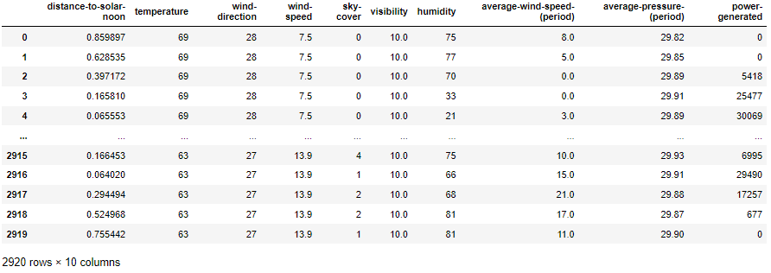

Slide 5
Distance-to-Solar-noon (radians): How far the sun is from its highest point in the sky.
Temperature (°C): The temperature of the air in degrees Celsius.
Wind Direction (degrees): The direction from which the wind is blowing.
Wind Speed (m/s): The speed of the wind in meters per second.
Sky-Cover: The amount of sky covered by clouds.
Visibility (km): How far one can see clearly, measured in kilometers.
Humidity (%): The percentage of moisture in the air.
Average Wind Speed (m/s): The average wind speed over a period.
Average Pressure (inHg): The atmospheric pressure measured in inches of mercury.
Power Generated: The amount of solar power generated (the target variable for prediction).

Slide 6
Exploratory Data Analysis

Slide 7
EXPLORATORY DATA ANALYSIS
Shape of the Dataset: 2920 rows and 10 columns.
Missing Values: Identify and handle any missing values in the dataset.
Summary Statistics: Calculate mean, median, standard deviation, and other statistics to understand the distribution of each variable.

Slide 8
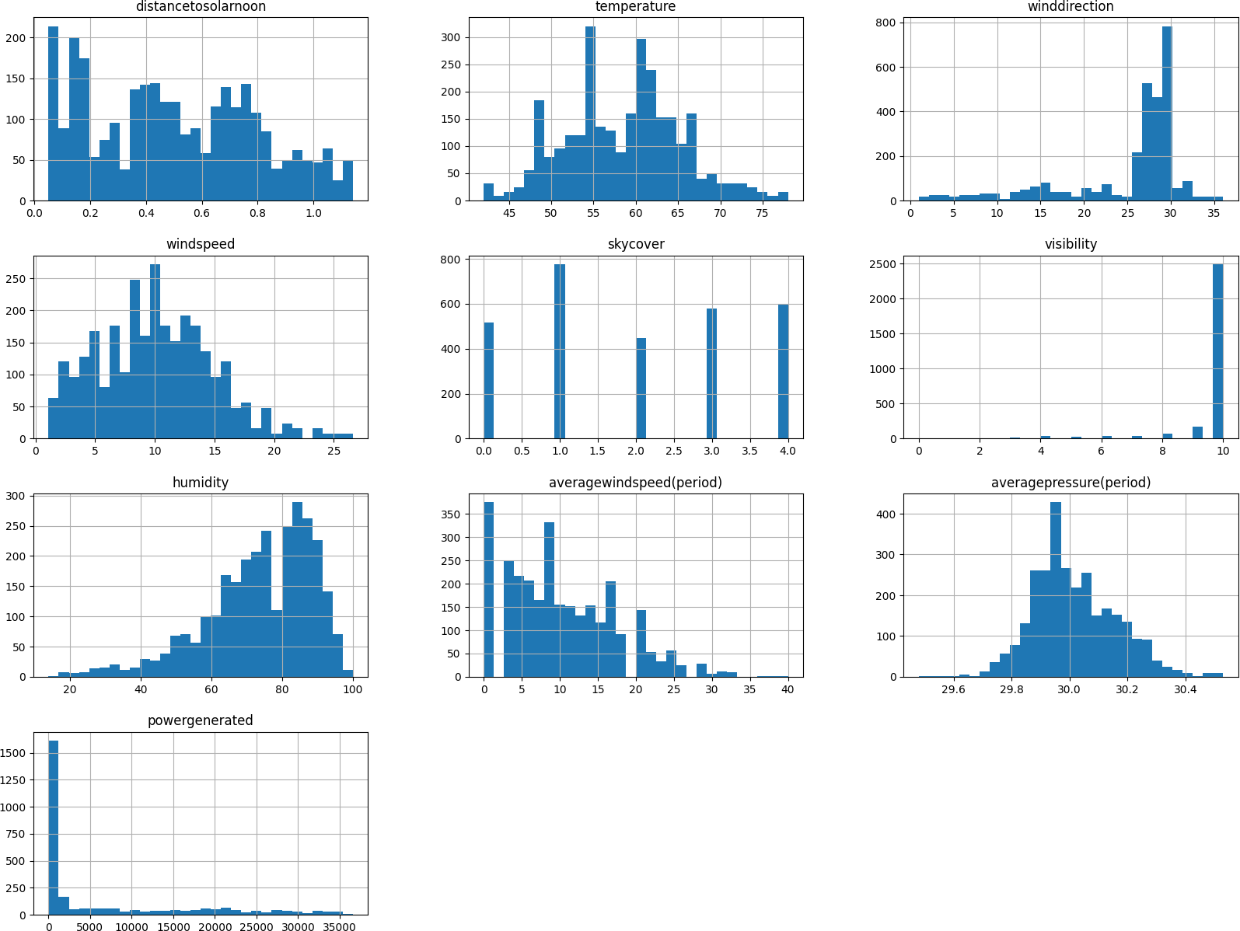
Histograms: Visualize the distribution of key variables like temperature, wind speed, and humidity to understand their spread and central tendency.

Slide 9
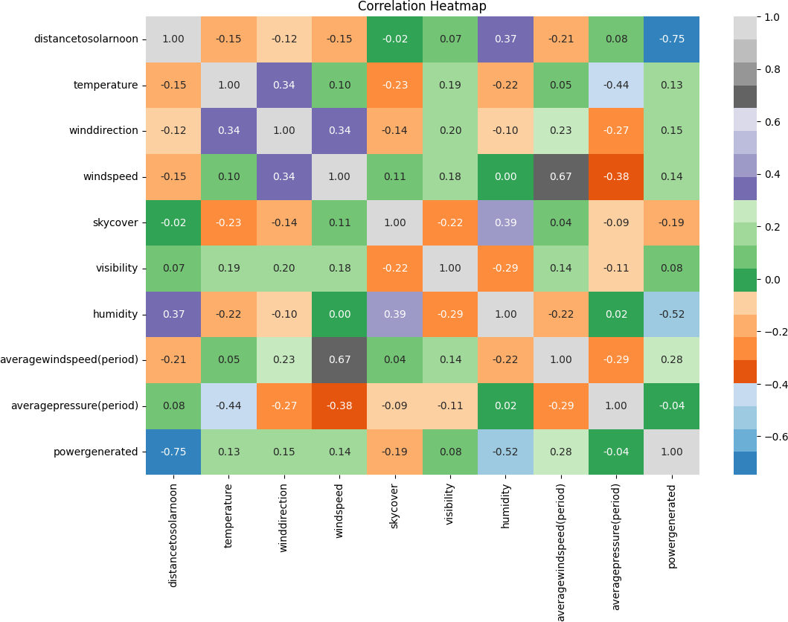
Correlation Matrix: Calculate the correlation between variables to see how they are related. This can help identify which variables have a strong relationship with the target variable (energy production).
Heatmap: A visual representation of the correlation matrix to easily identify strong positive or negative correlations.

Slide 10
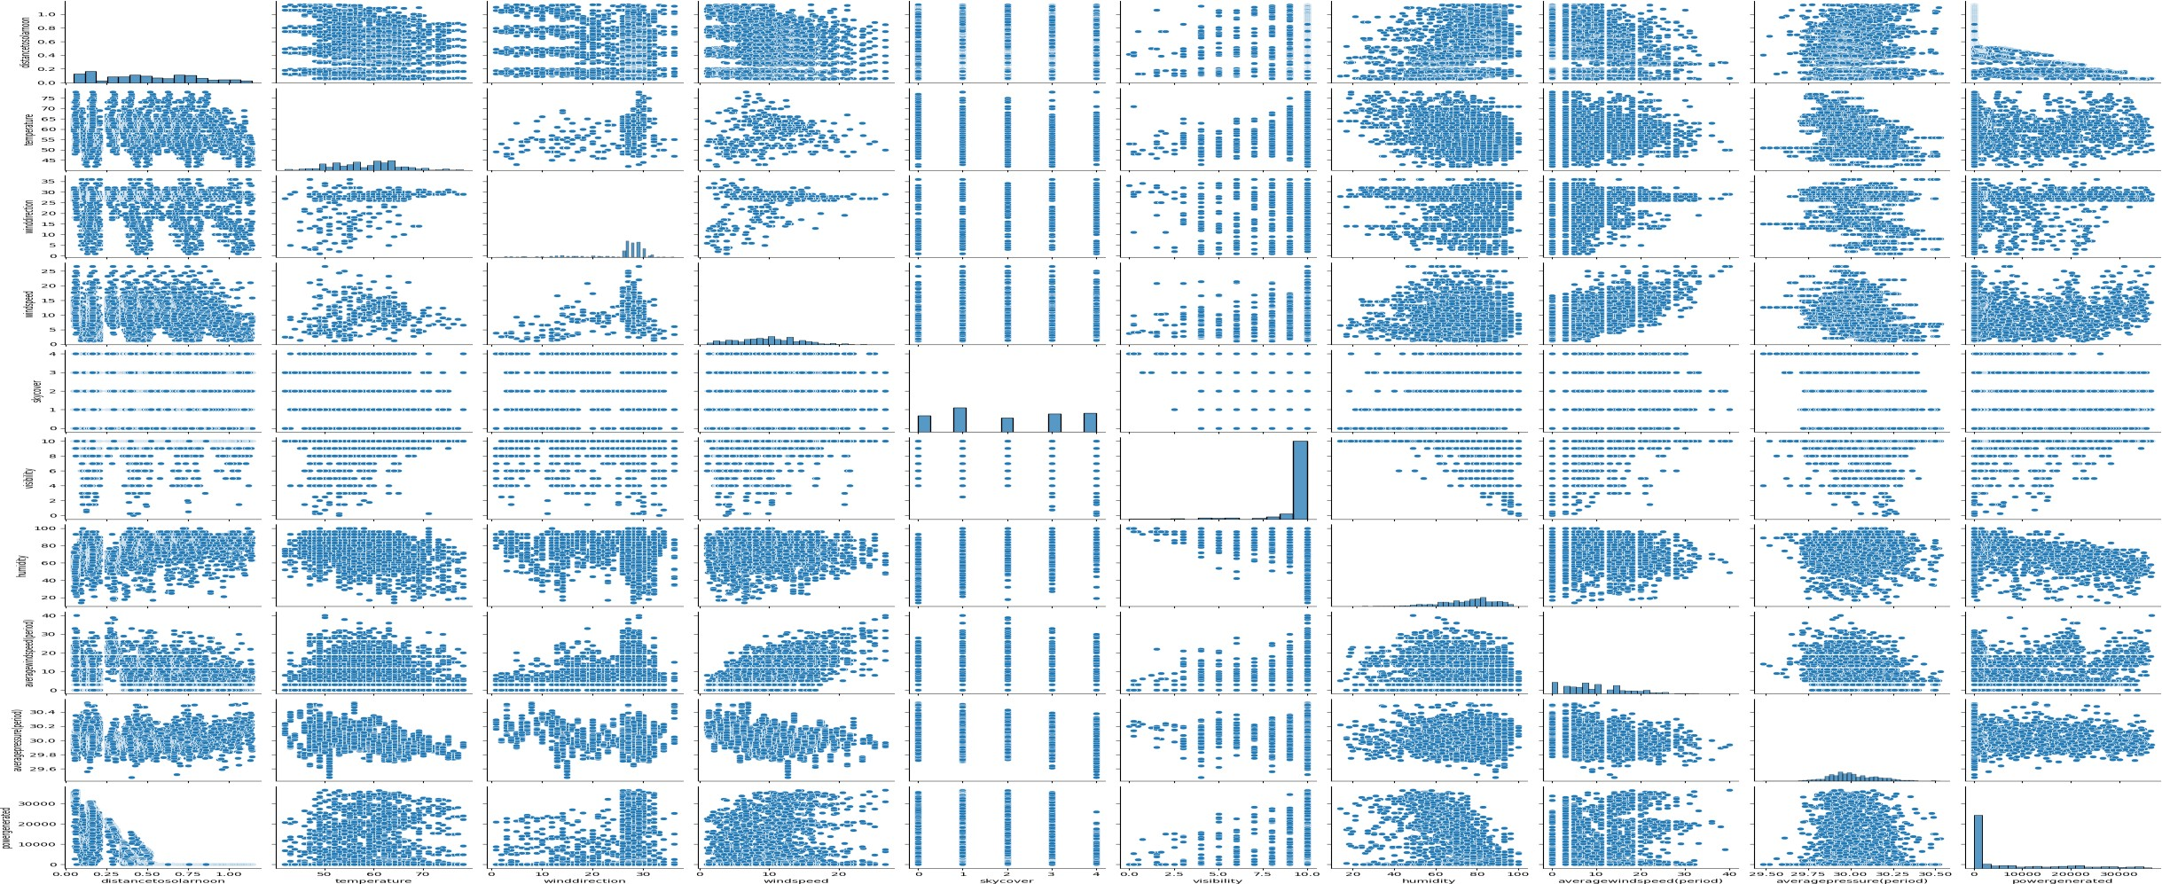
Pair Plots: Visualize pairwise relationships between multiple variables to detect patterns or clusters.
8/25/2024
9

Slide 11
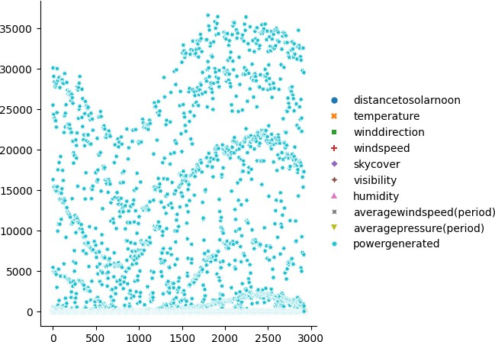
Relational plot :It is versatile and can be used to create scatter plots, line plots, and other types of relational plots by changing its parameters and combining it with other Seaborn function

Slide 12
MODEL BUILDING

Slide 13
RANDOM FOREST
XGBOOST
LIGHTGBM
SVR
RIDGE REGRESSION
LASSO REGRESSION
NEURAL NETWORK (MLP)
LINEAR REGRESSION

Slide 14
Why These Models…???
Ensemble Methods (Random Forest, XGBoost, LightGBM):
Chosen for their ability to combine multiple decision trees to improve predictive accuracy and
robustness
Regularization (Ridge, Lasso):
Employed to prevent overfitting by adding a penalty term to the loss function, promoting simpler
models
Non-Linearity Handling (SVR, Neural Network):
Selected to capture complex relationships within the data that linear models might miss. SVR uses
kernel functions to map data into higher-dimensional spaces, while neural networks learn non-
linear representations through interconnected layers.

Slide 15
Evaluation Metrics
Mean Absolute Error (MAE):
Measures the average absolute difference between predicted and actual values. It
provides a straightforward understanding of the typical prediction error in the same
units as the target variable.
Root Mean Squared Error (RMSE):
Calculates the square root of the average squared difference between predicted and
actual values. It penalizes larger errors more heavily than MAE and is sensitive to
outliers.
R-squared (R²):
Represents the proportion of the variance in the target variable explained by the
model. It ranges from 0 to 1, with higher values indicating a better fit. However, R²
alone may not be sufficient to assess model performance, as it can be artificially
inflated by adding more predictors, even if they don't improve predictive accuracy.

Slide 16
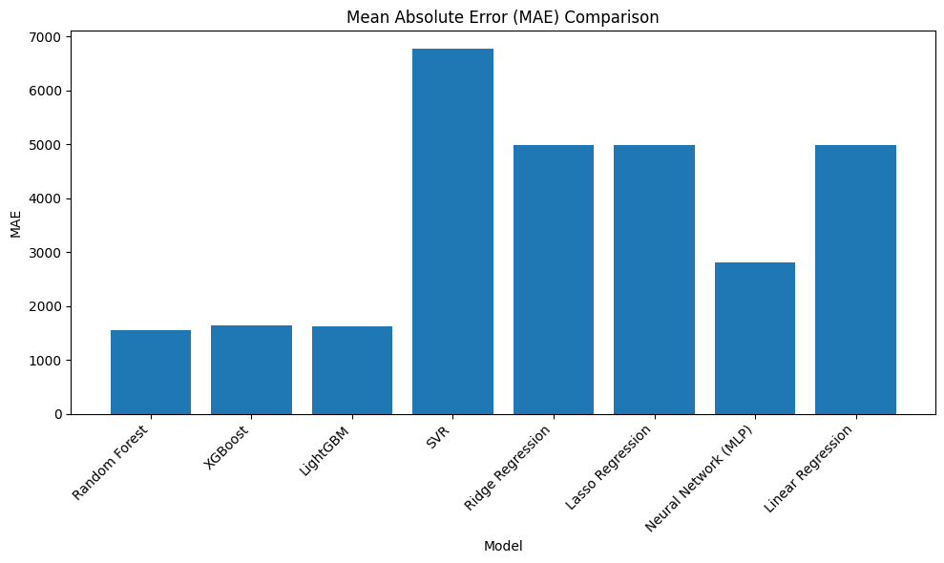
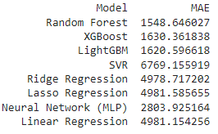

Slide 17
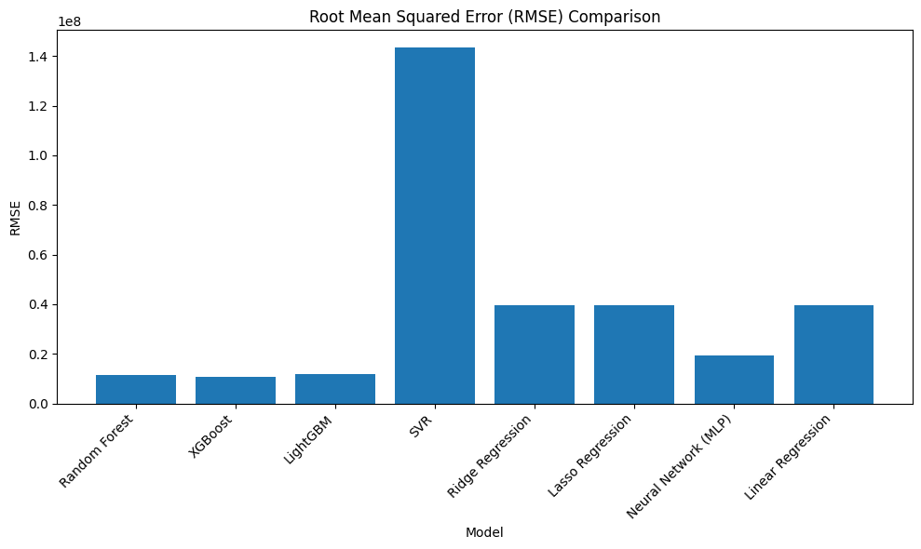
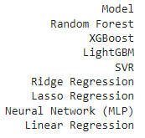
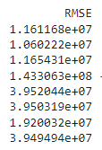

Slide 18
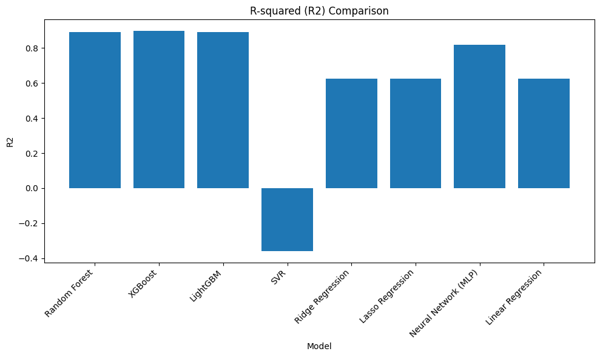
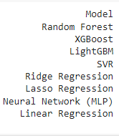


Slide 19
Key Findings
Model Performance:
- XGBoost emerged as the top performer with the lowest RMSE (Root Mean Squared Error) and
highest R2 (R-squared) score, indicating its strong predictive accuracy and ability to
explain variance in the target variable.
- Random Forest achieved the lowest MAE (Mean Absolute Error), suggesting it provides
predictions with the smallest average absolute deviation from actual values.
- Other models, including LightGBM, SVR, Ridge Regression, Lasso Regression, Neural Network
(MLP), and Linear Regression, also demonstrated reasonable performance, highlighting the
potential of diverse modeling approaches for this task.

Slide 20
Feature Importance:
- Analysis of feature importances from the XGBoost model revealed the
most influential factors in predicting solar power generation.
- Weather-related features like 'temperature' also played substantial
roles, emphasizing the impact of environmental conditions.
- 'winddirection' appeared to have a lesser impact, potentially indicating
its limited influence on solar power generation.
Neural Network Performance:
- The neural network (MLP) demonstrated competitive performance compared
to traditional models, achieving MAE and RMSE values close to those of
Random Forest and XGBoost.
- While XGBoost might retain a slight edge in terms of R2, the neural network
showcased its potential to capture complex relationships within the data.

Slide 21
Challenges
Hyperparameter Tuning
Training Time
Interpretability
Data Preprocessing
Overfitting
Model Selection

Slide 22
MODEL Deployment

Slide 23
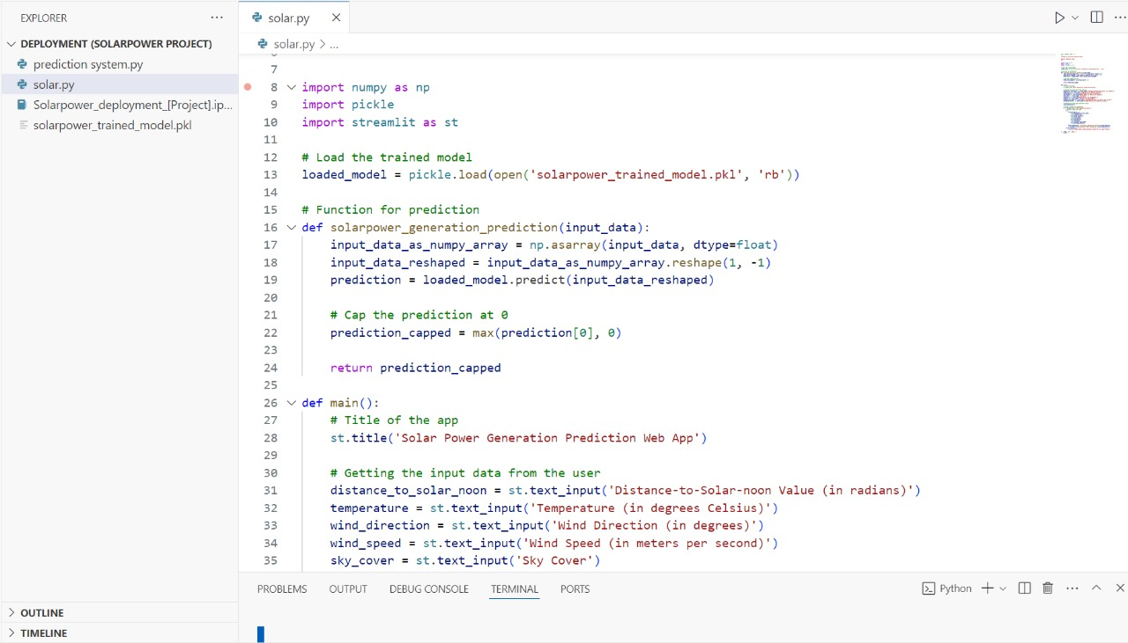

Slide 24
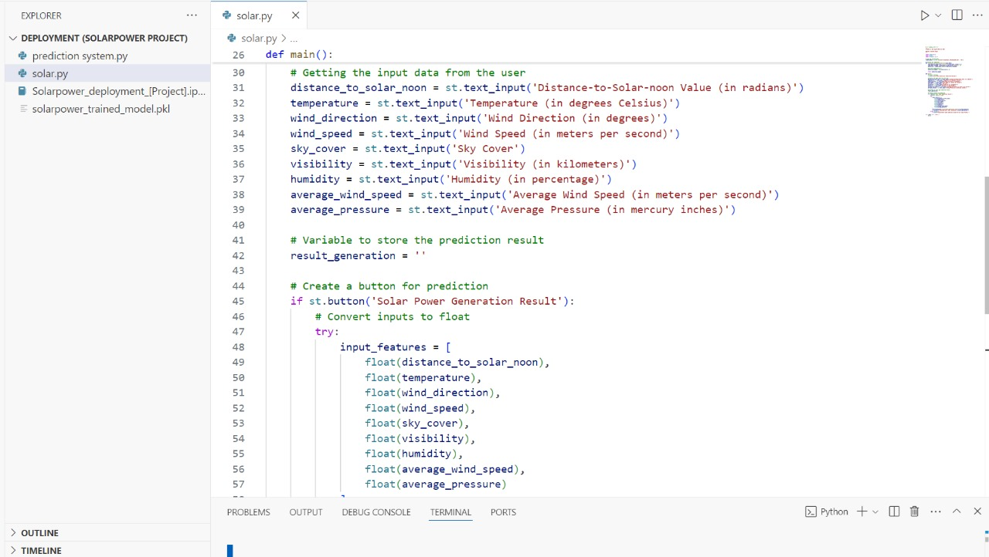

Slide 25
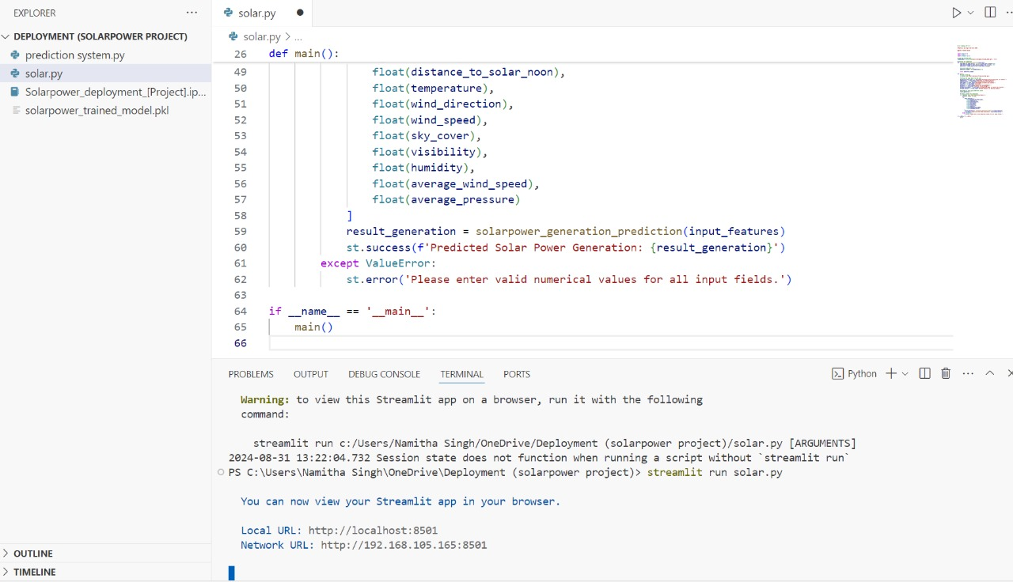

Slide 26
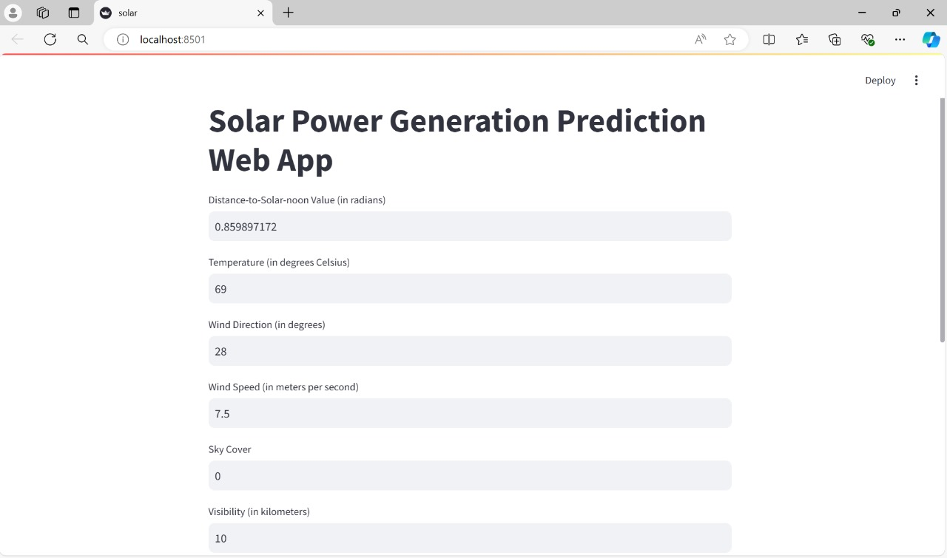

Slide 27
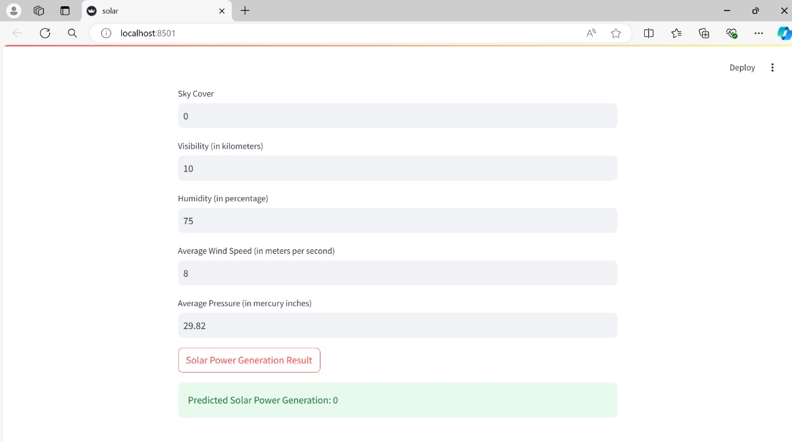

Slide 28
Thank You !

